Slide 1

Heidel Korea

Slide 2

Introduction
Heidel Korea Co., Ltd. is a trading company based on Frankfurt, Germany. We are specialized in distributing European goods abroad, especially the East Asian markets. Our range of products is from health supplements to heavy machinery. Currently, we have various customers on our list, and have a capability to successfully distribute your goods abroad.
We, Heidel Korea Co., Ltd., have started our business in accordance with our sincere conviction. Our business objective aims to lead newest trends with our fine products, and we always prioritize sincerity and integrity for our business strategy.
The foundations for Heidel Korea Co., Ltd. were laid by Internationale Handelsgesellschaft mbH CS Königstein as long ago as 2007.
With its 19 German companies and four foreign businesses, Heidel Korea Co., Ltd. produces over 20,000 high-quality food and non food products, making it one of the biggest own-brand producers in the world.
Heidel Korea Co., Ltd. is part of the Internationale Handelsgesellschaft mbH CS Königstein, Deutschland’s number one in retail trade. It exports quality German products to around 50 countries. Its customers include well known major multinationals.

Slide 3
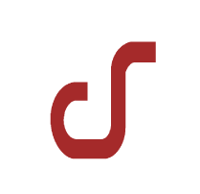






Our Brands
[CS-Koenigstein]
(Exclusive contract)
(MOU)
[Heidel Korea]
[Kijoon International]
(Foods)
(Health)
(Sweets)
(Living)

Slide 4
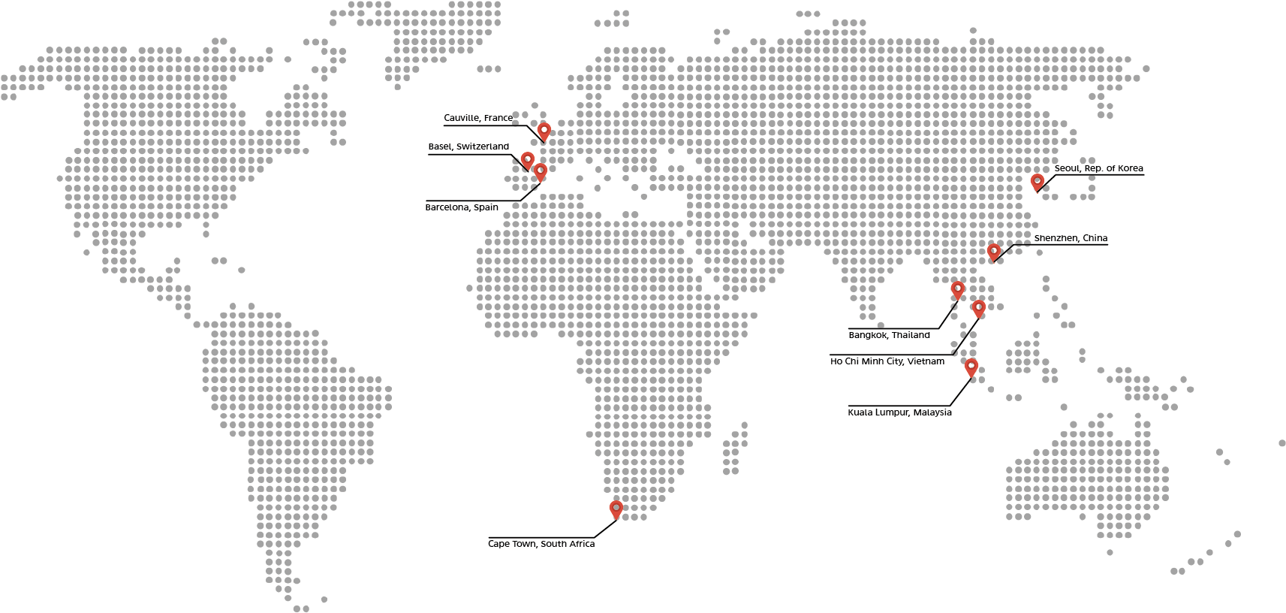
Our online & offline customers

Slide 5

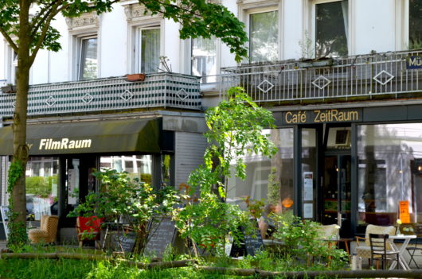
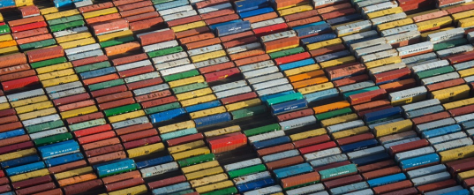
CS Königstein and Heidel
Our Strategies
Internationale Handelsgesellschaft mbH CS Königstein is close to the various markets, sets trends, and surprises people with the innovative products and services.
CS Königstein companies produce over 200 different products, offering unbeatable value for money and with traditional and firmly established Deutschland appreciation of quality.
Over many decades, CS Königstein has acquired
an unique know-how in the development, production and marketing of Private Label concepts.
Innovations are one of the main drivers of our business. Every year we develop several hundred new products, including so-called “New-to-the-world products”.
As subsidiaries of Internationale Handelsgesellschaft mbH CS Königstein, Deutschland’s leading food retailer, we understand how the retail sector thinks and acts.

Slide 6
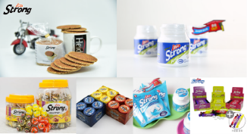
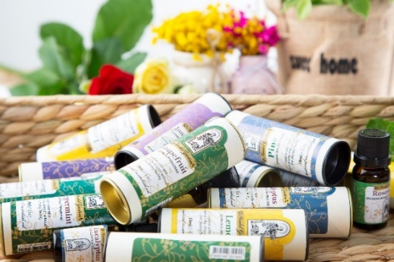
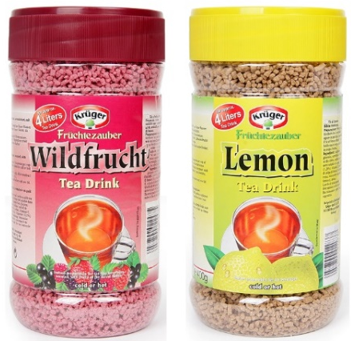
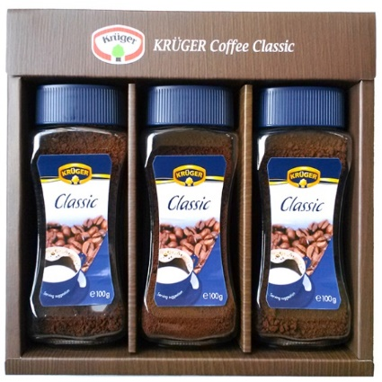
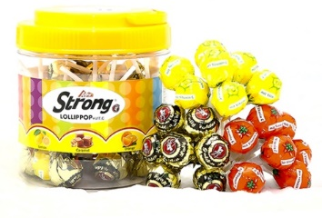
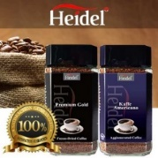
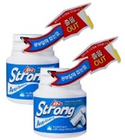
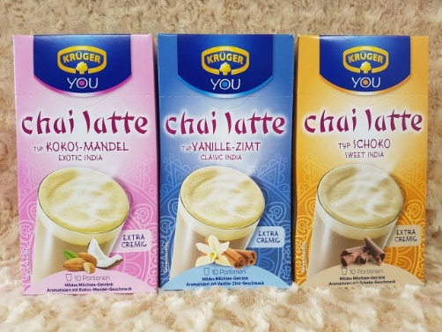
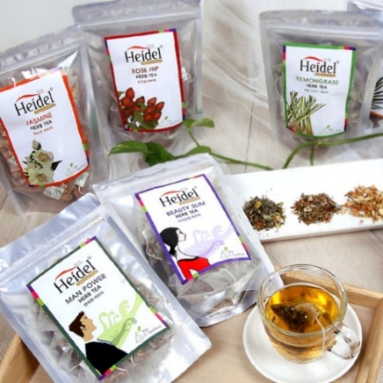
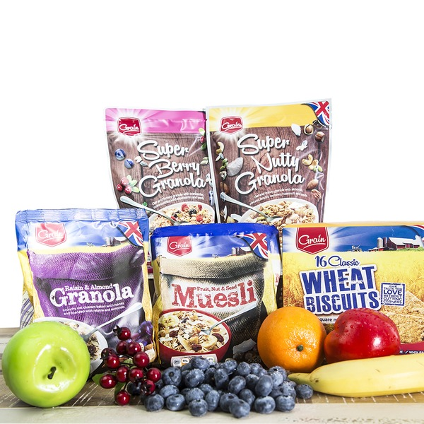
Product list
✔ Heidel Coffee
✔ Heidel Herb Tea
✔ Krüger Fruit Tea/Coffee/Chai latte
✔ Bokomo Muesli/Granola/Wheat Biscuits
✔ Edel Candy
✔ HeidelPharm Gummy Jelly
✔ HeidelPharm Aroma Lamp
✔ HeidelPharm Aroma Oil
✔ Alps Strong Stroop Waffle
✔ Alps Strong Ice Dream
✔ Alps Strong Chewing Gum
✔ Alps Strong Lollipop

Slide 7
(Foods)

Slide 8
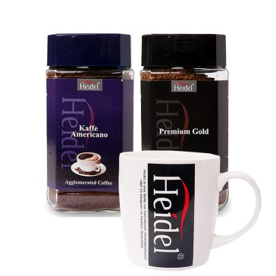
  Heidel Coffee
  Heidel Coffee is a brand from Deutsche Extrakt Kaffee,
  the one of the world's chosen directly from the best-conditioned tropical regions and leading retailers of instant coffee.
  Coffee beans are made with the know-how of experienced roosters.
  There are two types of Heidel Coffee:
  - Premium Gold
  - Instant Coffee

Slide 9

  Heidel Herb Tea
  Our selection of tea is specially selected from all around the world and offers premium flavor and health benefits.
  Varieties of Heidel Herb Tea:
  Hibiscus, Peppermint, Lemon Grass, Rose Hip,
  Lemon Balm, Rooibos, Jasmin, Fennel, Rosemary,
  Chamomile, Men Power, Beauty Slim

Slide 10
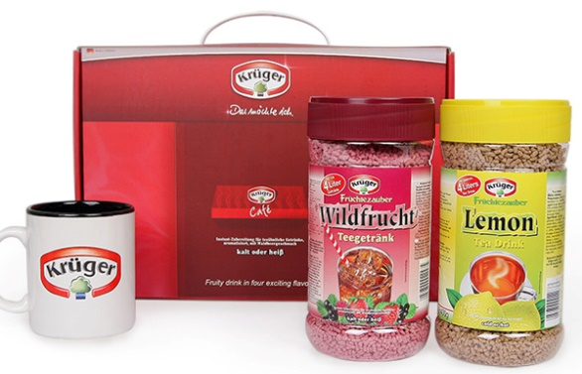
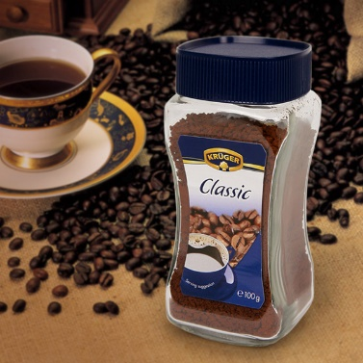
  Krüger Fruit Tea & Chai latte & Classic Coffee
  The two kinds of fruit tea, the fresh lemon and tropical fruit flavor, are made by the Krüger. These fruit tea is one of the most popular flavors in the market. It also dissolves in cold water, so it is great for the summer!
  The Chai Latte has an exotic and delicious taste, with Indian tea and milk inside. Enjoy the three flavors and sweetness of aroma vanilla and cinnamon, coconut and almonds, and chocolate!
  Krüger's Classic Coffee is produced by a German luxury coffee maker. It is an instant coffee that reproduces the taste of brewed coffee! Enjoy the neat and rich flavor of the Krüger's Classic Coffee.

Slide 11
  Bokomo Muesli & Granola & Wheat Biscuits
  Bokomo Muesli consists of oats, grains, dried fruit and nuts.
  It is high-fiber and a good supply of vitamin B and iron.
  All in all, it is very good for healthy breakfast as it is rich in unsaturated fatty acids and vitamins that are beneficial to your health.
  Bokomo Granola is very suitable for those who are looking for healthy breakfast in the morning. There are three kinds of granola, which is Super Berry, Super Nutty and Raisin & Almond.
  Bokomo Wheat Biscuits contain 94% of healthy wholegrain wheat and rich in fiber. It is a healthy snack which can be enjoyed by men, women, and children of all ages!

Slide 12
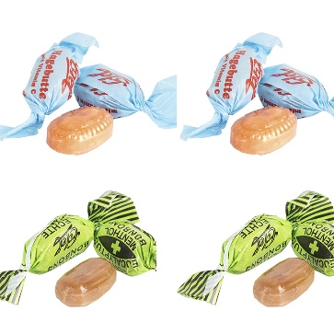
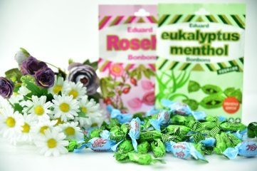
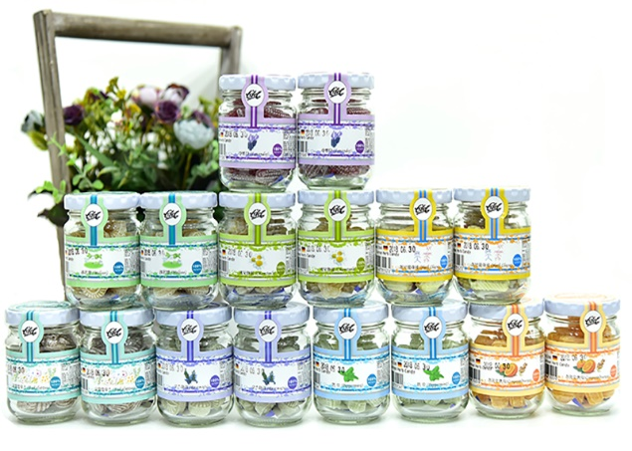
  Edel Bon Bon & Herb Candy
  There are two types of Edel Bon Bon, Eucalyptus and Rose hip.
  Eucalyptus Bon Bon has minty taste that makes your mouth fresh, and Rose hip Bon Bon contains rose hip fruit extract which makes the taste sweet and sour.
  Edel Herb Candy is made out of high-quality herbs produced in Germany.
  There are 12 varieties of herb candies as below:
  fennel, eucalyptus, chamomile, lavender, lemon balm, mint,
  rosemary, siege, ginger orange

Slide 13
(Health)

Slide 14
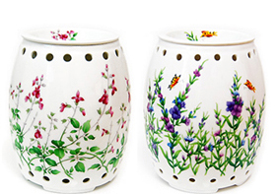
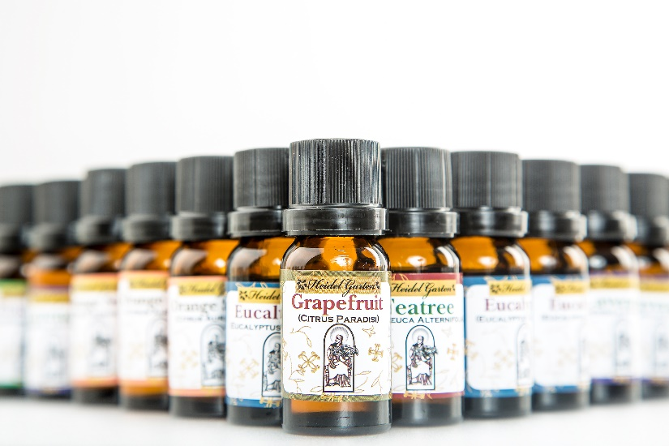
Aroma electric lamp
Aroma oil

Slide 15
(Sweets)

Slide 16
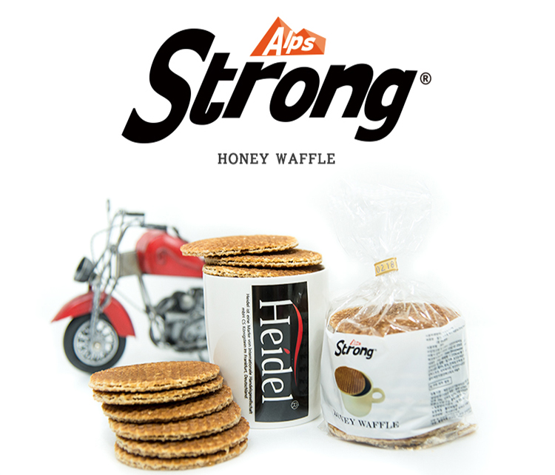
  Alps Strong Honey Stroop Waffle
  Alps Strong Stroop Waffles are packed with sweet honey in between properly cooked waffles and have a delicate cinnamon flavor. Stroop Waffles are sweet and chewy, and they are even more delicious when it is served cold.

Slide 17
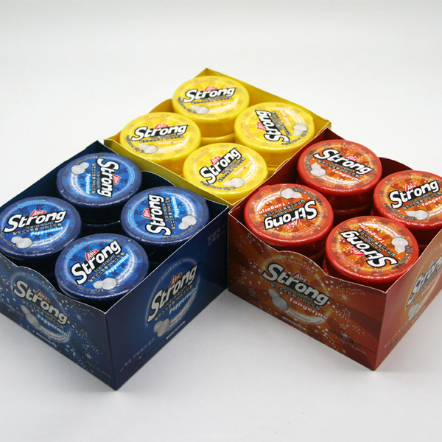
  Alps Strong Ice Dream
  Alps Strong Ice Dream is a perfect solution to refresh your mind and mouth! It instantly helps you boost energy and stay awake.
  There are three types of Ice Dream:
  Lemon & Raspberry, tangerine and peppermint

Slide 18
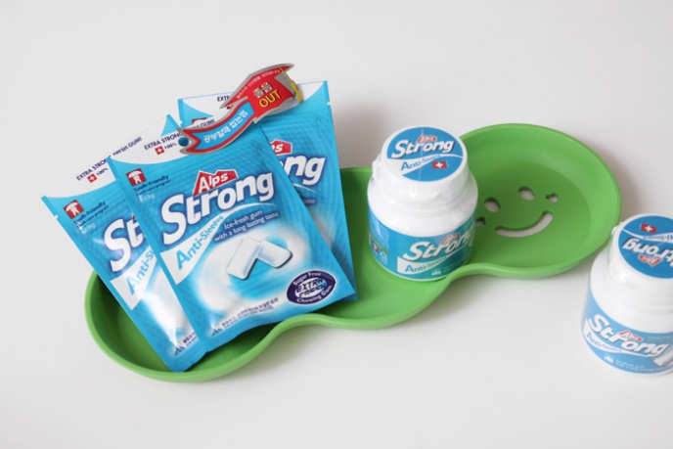

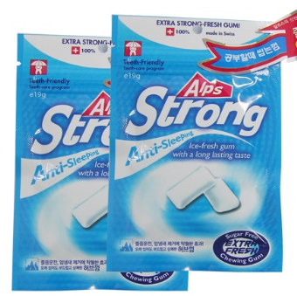
  Alps Strong Anti-Sleeping Gum
  Alps Strong Anti-Sleeping Gum is recommended to students, drivers, and those who have bad breath. The taste of this gum is stronger and more minty than any other chewing gum, and the flavor of Alps Strong Gum is unforgettable!

Slide 19

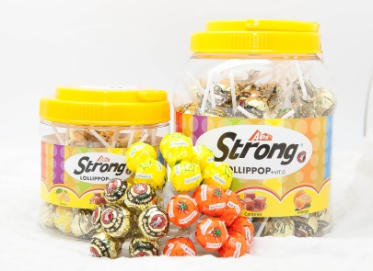
  Alps Strong Lollipop
  The Belgian Alpine Strong Lollipop offers three flavors –
  sweet and aromatic caramel, fresh orange, and sweet lemon flavors.
  Alps Strong Lollipop is perfect for everyone regardless of age!

Slide 20
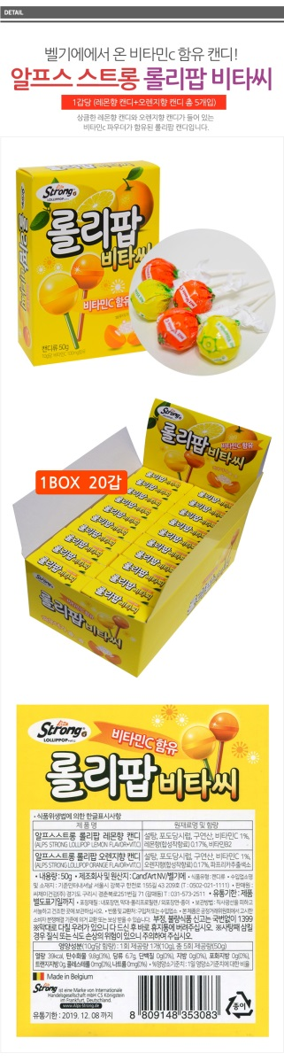
  Alps Strong Lollipop Vita C
  Alps Strong Lollipop Vita C is made in Belgium!
  It is a lollipop with a refreshing lemon and orange flavor with vitamin C powder.

Slide 21
(Living)

Slide 22
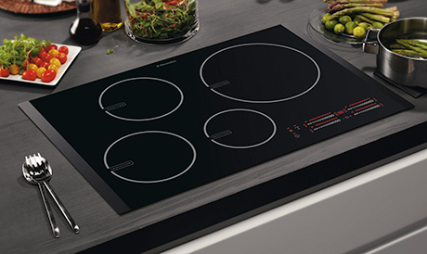
Electrolux Induction

Slide 23

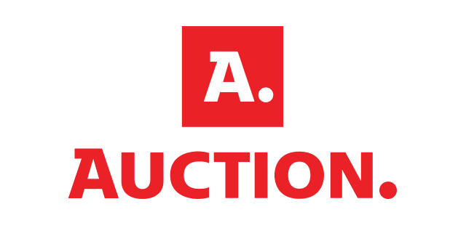


Distribution
We directly distribute our products with major Korean department stores and supermarkets both offline and online.

Slide 24
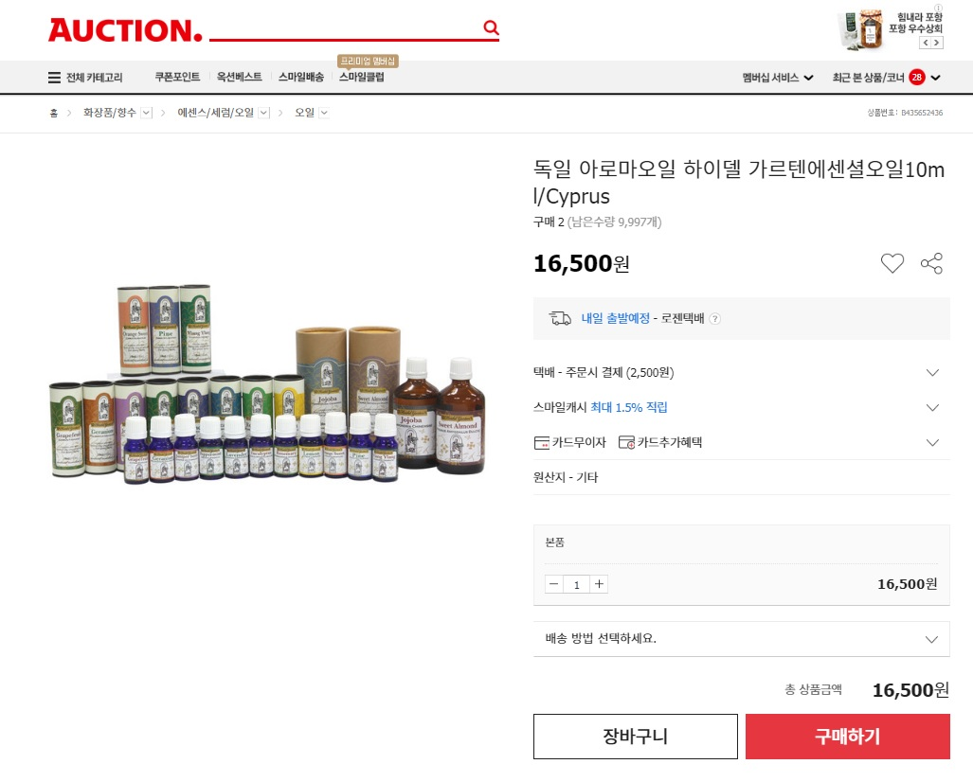
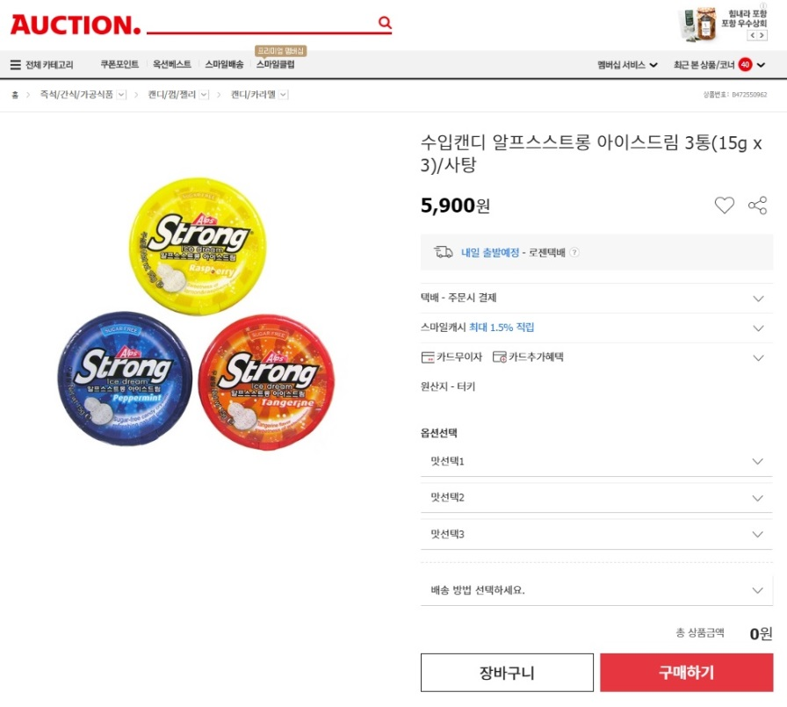
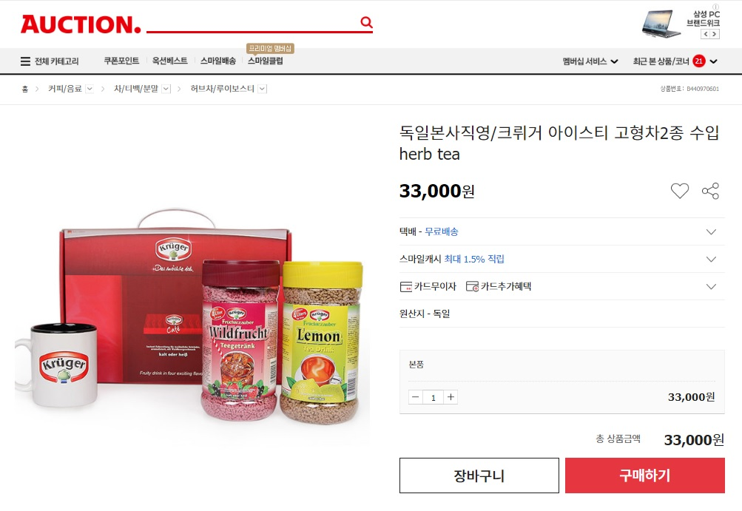
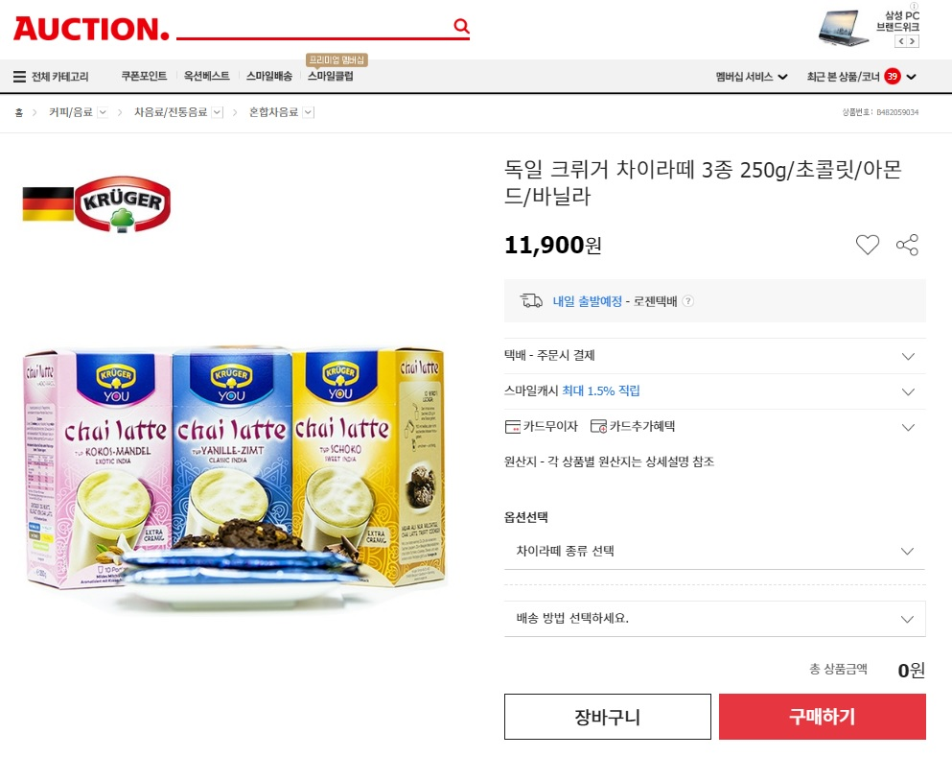
<Auction> E-Commerce Market Contracts

Slide 25
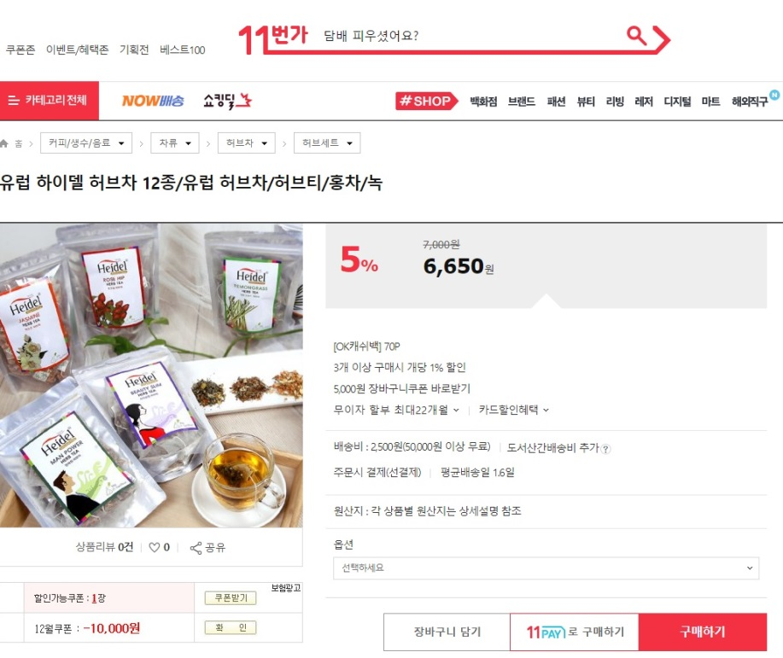
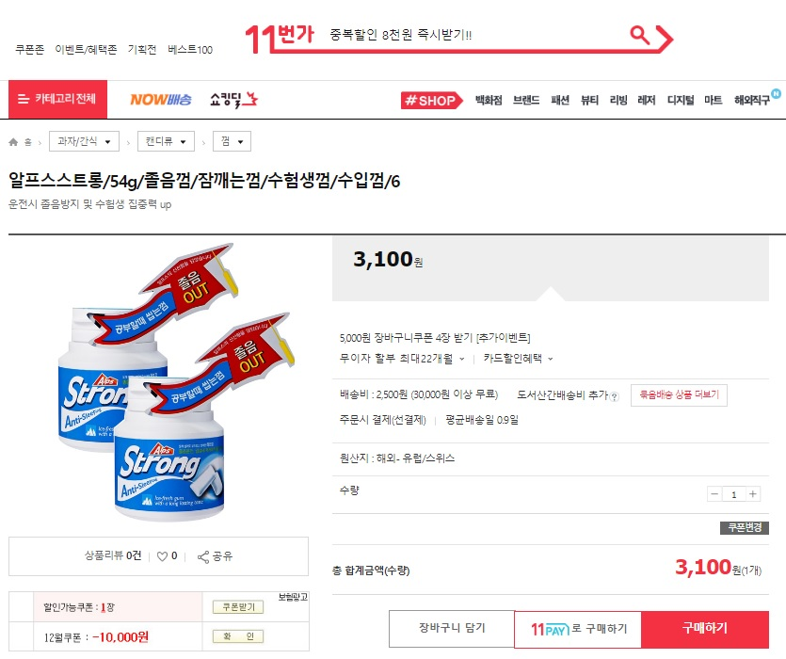
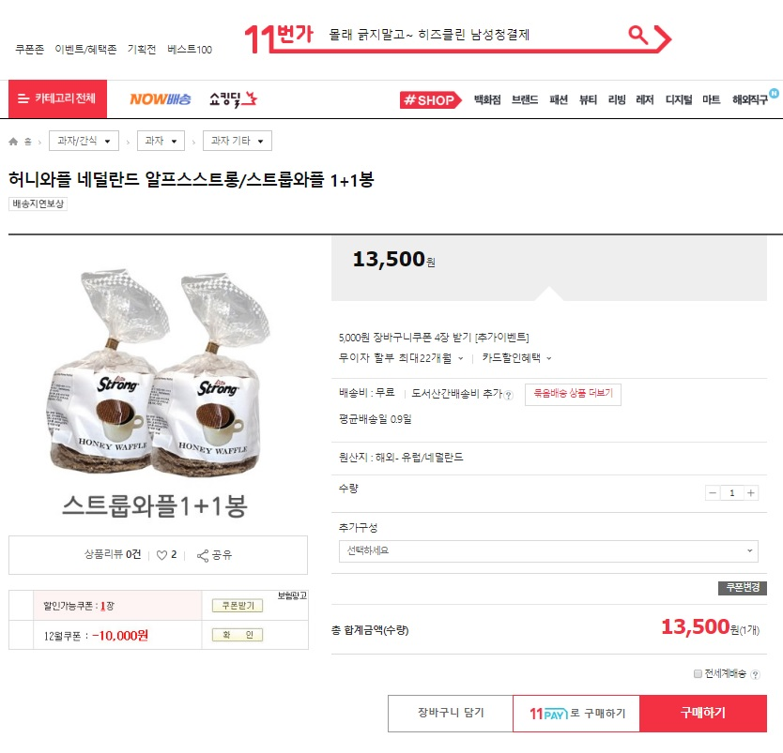
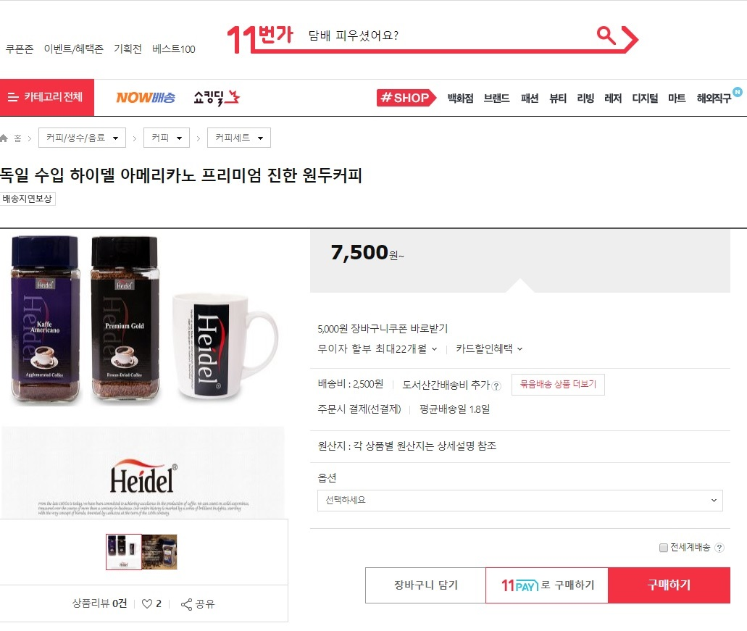
<11st Street> E-Commerce Market Contracts

Slide 26
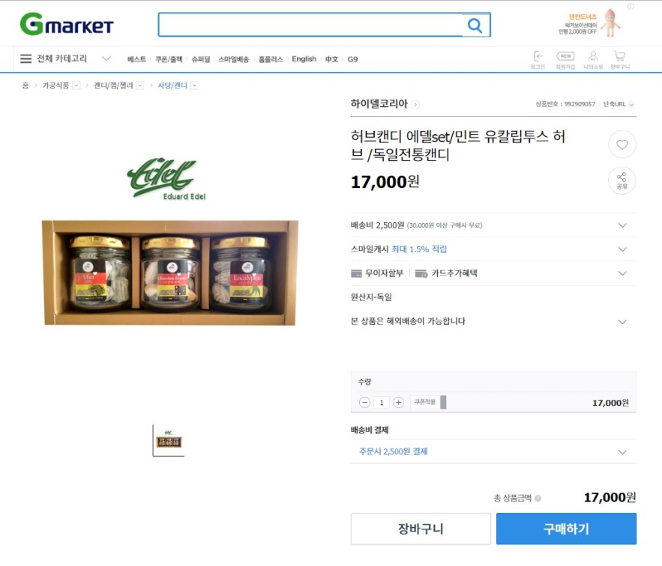
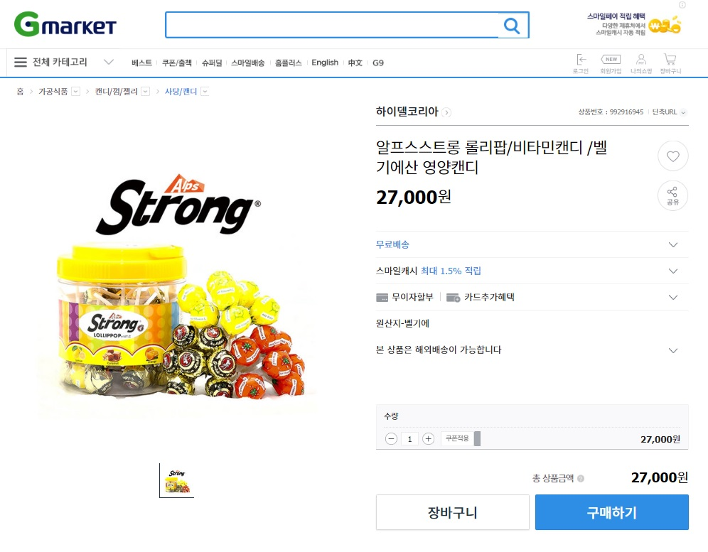
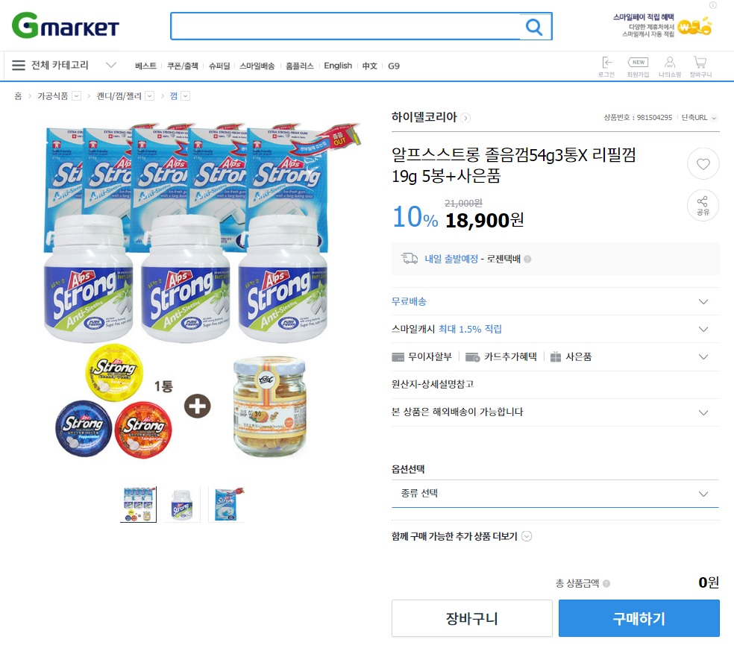
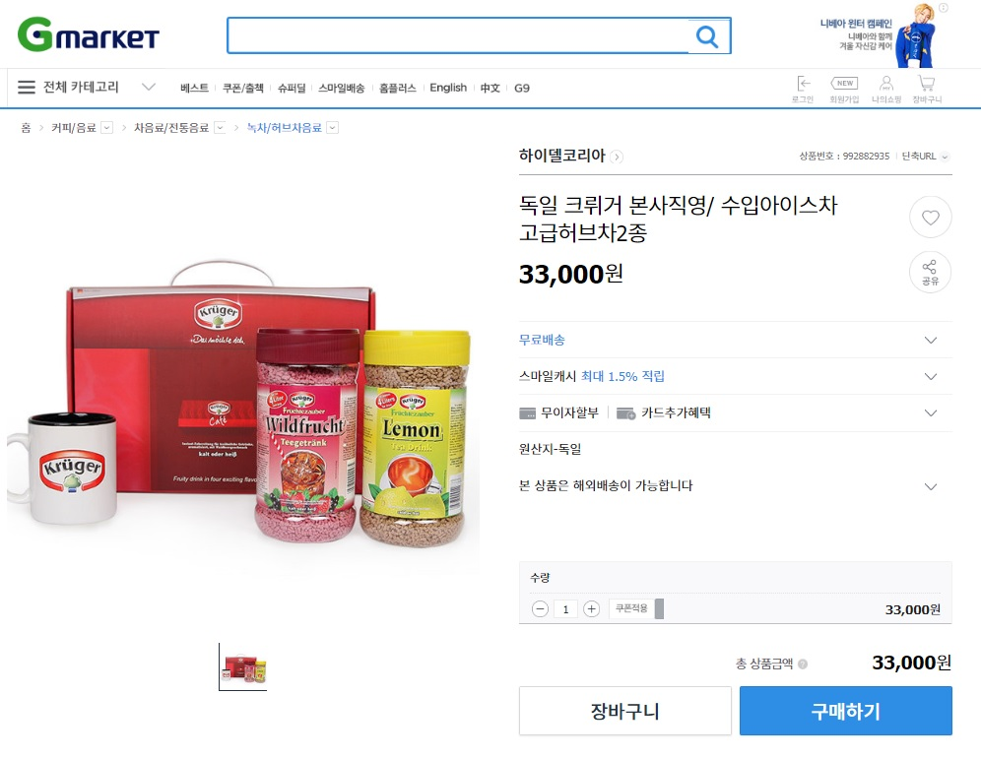
<Gmarket> E-Commerce Market Contracts

Slide 27
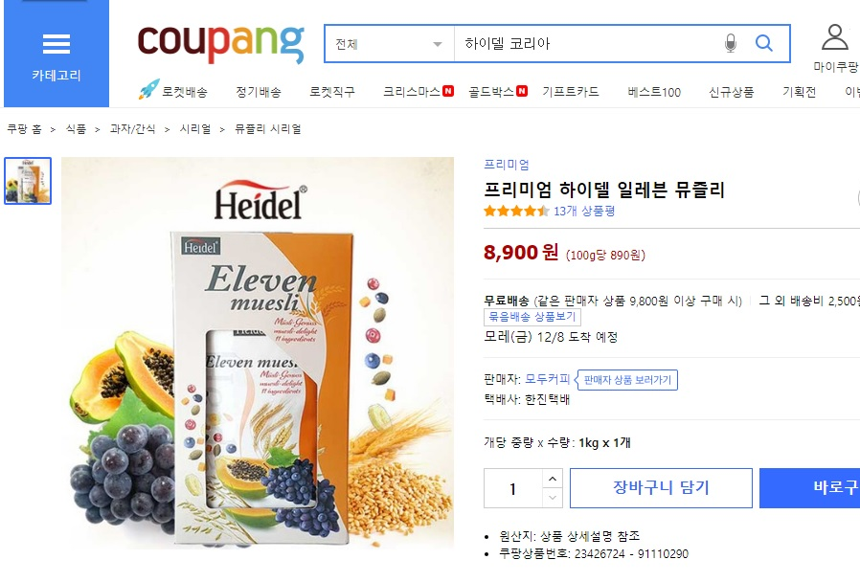
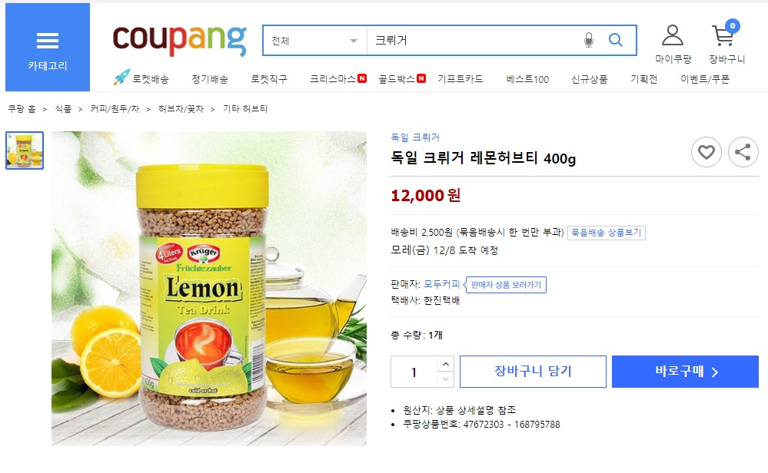
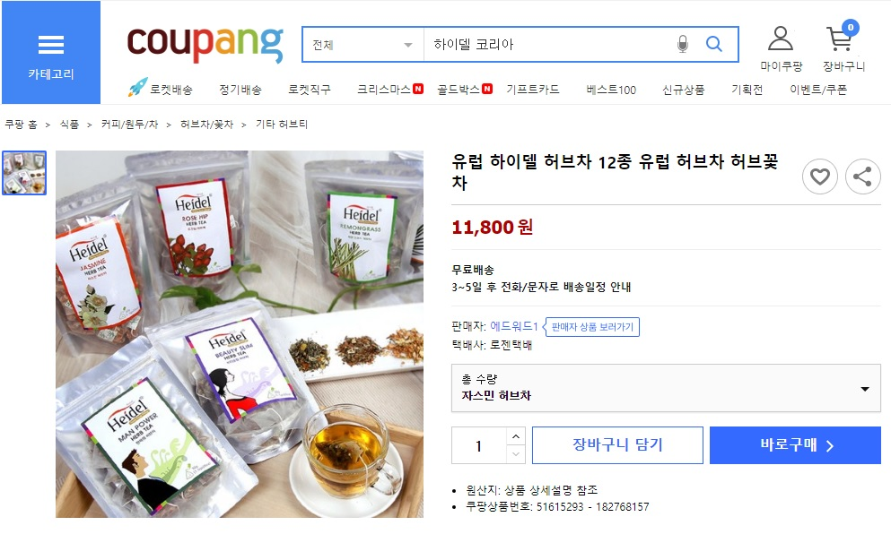
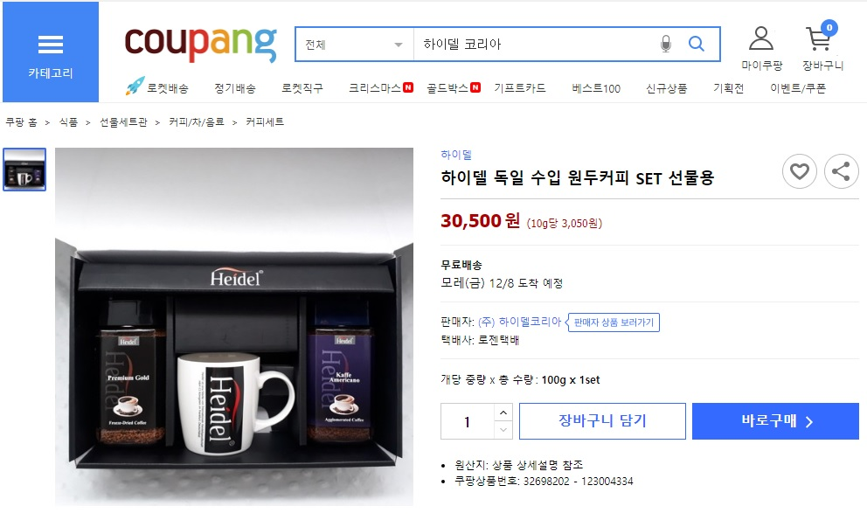
<Coupang> E-Commerce Market Contracts

